Slide 1
Eagle Swoop Imitation
TEAM 2
GRANT METTS, RORY HUBBARD, KEVIN DAI, YUFAN ZHANG
Notes:
Rory

Slide 2
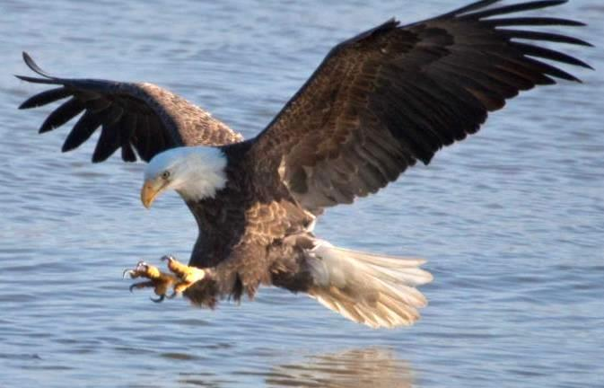
Introduction
Use a drone to emulate how an eagle swoops and grabs prey
Previously demonstrated by the GRASP Lab at the University of Pennsylvania
mdc.mo.gov
Different Hardware
Different Challenges
Different Results
Notes:
Rory

Slide 3
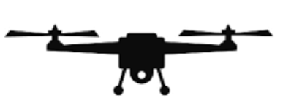



Notes:
Rory

Slide 4
Planned Operations
Goal: Minimize tracking error over the trajectory & minimize object jerk
Steps of Operation:
1. Generate trajectory
2. Stabilize after initialization
3. Dive towards object
4. Grasp object, rise & stabilize
Notes:
Rory

Slide 5
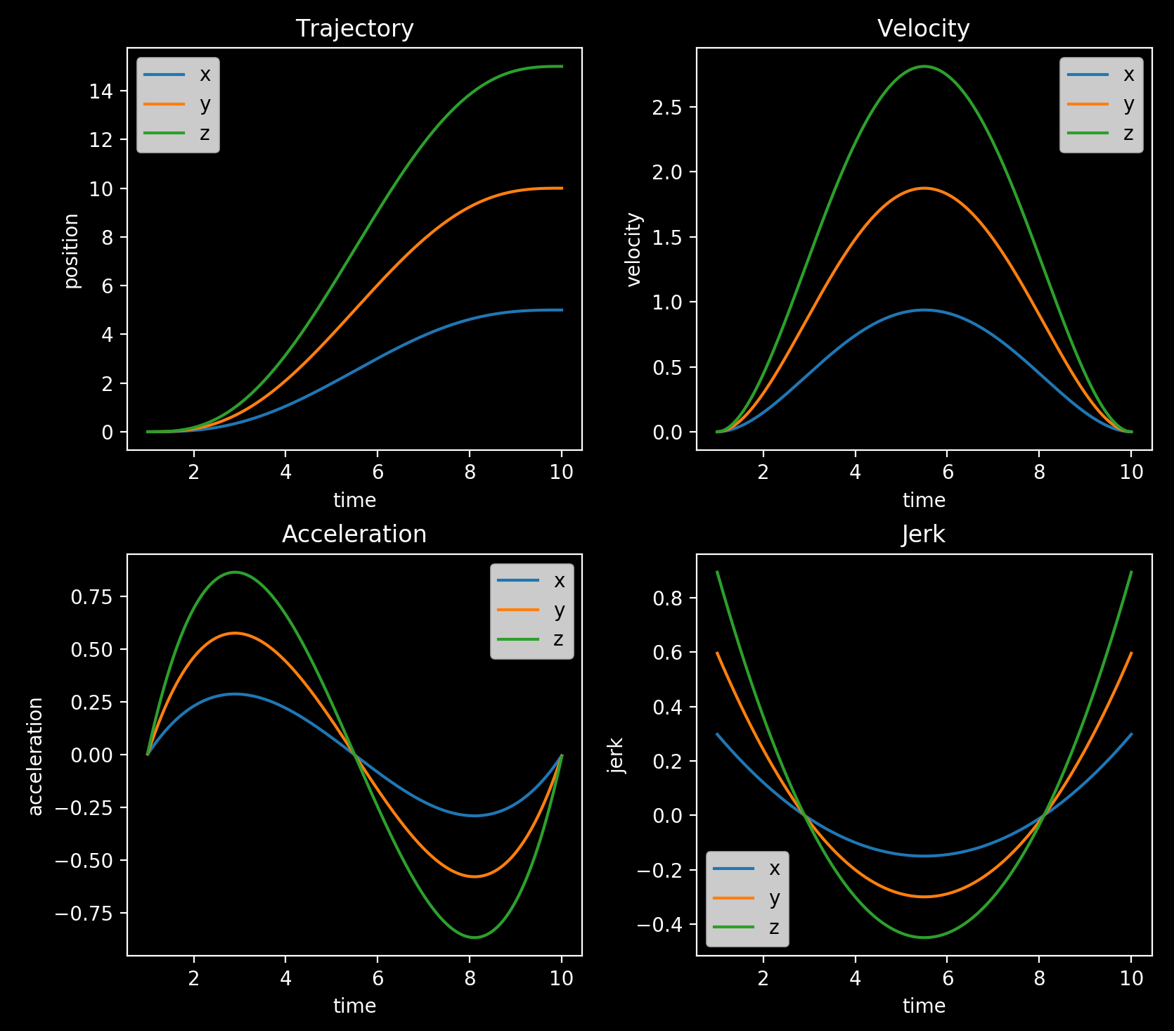
Minimum Jerk Trajectory
Notes:
Rory

Slide 6
General System Architecture
Optitrak Computer
Optitrak
System Pose
ROS
Drone Onboard
Reference Trajectory
Trajectory Planner
Position Controller
YPR
Drone Comms
YPR
Attitude Controller
Target ID
Our areas of work
Notes:
Yufan

Slide 7
Project Milestones
Set up device communications
Simulate CrazyFlie control system
Design controller in simulation
Implement controller on CrazyFlie
Notes:
Yufan

Slide 8
Communication architecture
1. Set up device communications
2. Simulate CrazyFlie control system
3. Design Simulation controller
4. Implement Controller on CrazyFlie
Drone <--> Computer: Bluetooth
Computer <--> Optitrack: Lab local internet
Optitrack <--> Drone: Interconnection via computer
Notes:
Yufan

Slide 9
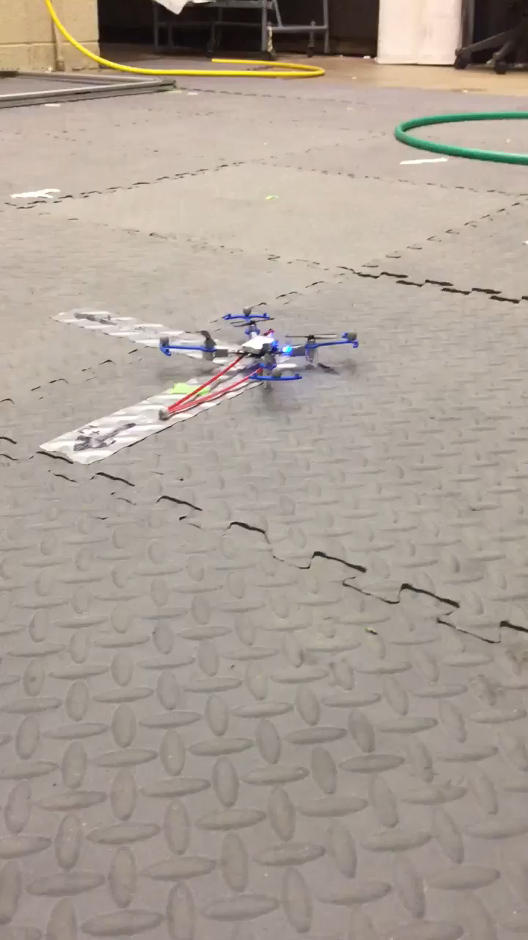
Communication test
1. Set up device communications
2. Simulate CrazyFlie control system
3. Design Simulation Controller
4. Implement Controller on CrazyFlie
Hovering control baseline
Notes:
Yufan

Slide 10
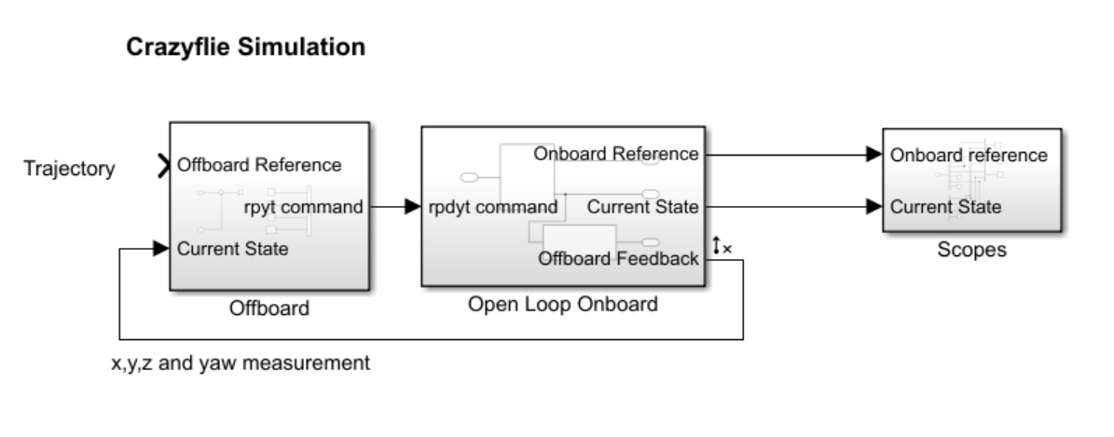
Control System Simulation
1. Set up device communications
2. Simulate CrazyFlie control system
3. Design Simulation Controller
4. Implement Controller on CrazyFlie
Source: Adapted from work of Marcus Greiff at https://github.com/mgreiff/crazyflie-project.
Calculates state and outputs high level commands (expected roll, pitch yaw and thrust)
Low level execution and state feedback
Notes:
Grant

Slide 11
High level control architecture
1. Set up device communications
2. Simulate CrazyFlie control system
3. Design Simulation Controller
4. Implement Controller on CrazyFlie
Source: Adapted from work of Marcus Greiff at https://github.com/mgreiff/crazyflie-project.
State input (x,y,z and yaw) to
Controller output (roll, pitch, yaw and thrust)
Notes:
Grant

Slide 12
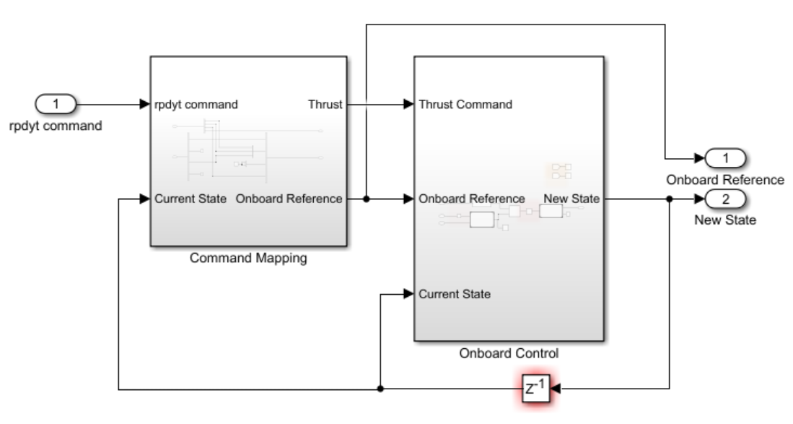
Low level control architecture
1. Set up device communications
2. Simulate CrazyFlie control system
3. Design Simulation Controller
4. Implement Controller on CrazyFlie
Expand block
1. Low level PD controller inputs roll, pitch and yaw.
2. Outputs torques for each rotor.
3. Simulation converts torques and thrust into angular velocity input for each rotor
4. CrazyFlie dynamics model outputs next state
Notes:
Grant

Slide 13
Controller Selection
1. Set up device communications
2. Simulate CrazyFlie control system
3. Design Simulation Controller
4. Implement Controller on CrazyFlie
i. Low level control: Uses onboard default PD attitude controller
ii. High level control:
 | Pros | Cons
MPC | Plans ahead, great for trajectory following | Needs dynamics model
PID | No need for SysID | Controls only the current time step
Notes:
Grant

Slide 14
Controller Design
1. Set up device communications
2. Simulate CrazyFlie control system
3. Design Simulation Controller
4. Implement Controller on CrazyFlie
MPC
For high level MPC, we obtained a dynamics model using MATLAB linearization tools, linearized at the initial hovering point:
x(T+1) = A*x(T) + B*u(T)
y(T) = C*x(T) + D*u(T)
which incorporates the system with onboard PD stability controller, signal conversions etc. It is a direct mapping from state error to the observed state output
u(T): Control input [roll, pitch, yaw rate, and thrust]
y(T): Output/observed states [x, y, z and yaw]
Notes:
Kevin

Slide 15
1. Set up device communications
2. Simulate CrazyFlie control system
3. Design Simulation Controller
4. Implement Controller on CrazyFlie
Dynamics for MPC
Method: Linearize at initial hovering point using Matlab linearization tools
Result:
A: [19 x 19] matrix B: [19 x 4] matrix
C: [4 x 19] matrix D: 0
x(T+1) = A*x(T) + B*u(T)
y(T) = C*x(T) + D*u(T)
Notes:
Kevin

Slide 16
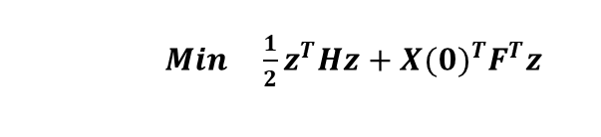
MPC Simulation
1. Set up device communications
2. Simulate CrazyFlie control system
3. Design Simulation Controller
4. Implement Controller on CrazyFlie
Objective:
Parameters:
Cost function | J = J(control) + J(control change) + J(state error)
Planning horizon N | 30
Tracking error penalty Q | diag([1000, 10000, 1000, 1000])
Control usage penalty R | diag([1, 1, 1, 1e-8])
Control change penalty RD | diag([1/100, 1/100, 1/10, 1e-8])
u(T): Control input [roll, pitch, yaw rate, and thrust]
y(T): Output/observed states [x, y, z and yaw]
Notes:
Kevin

Slide 17

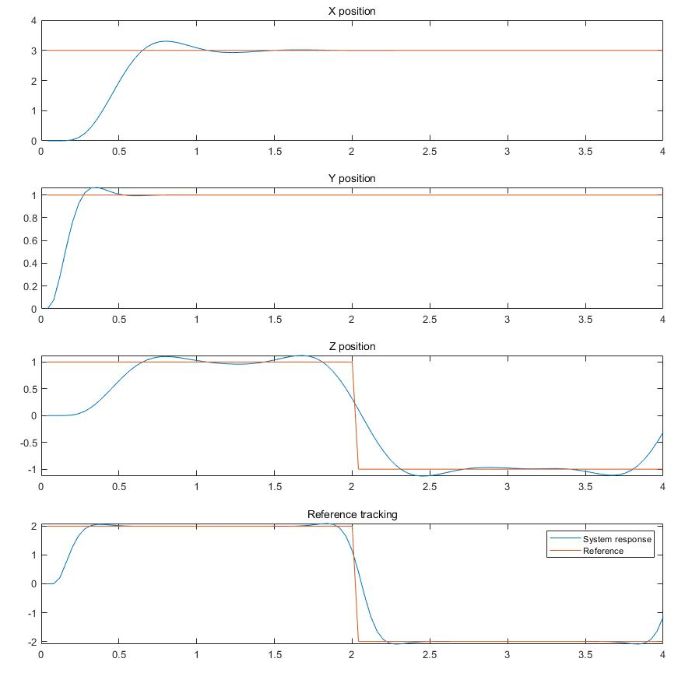
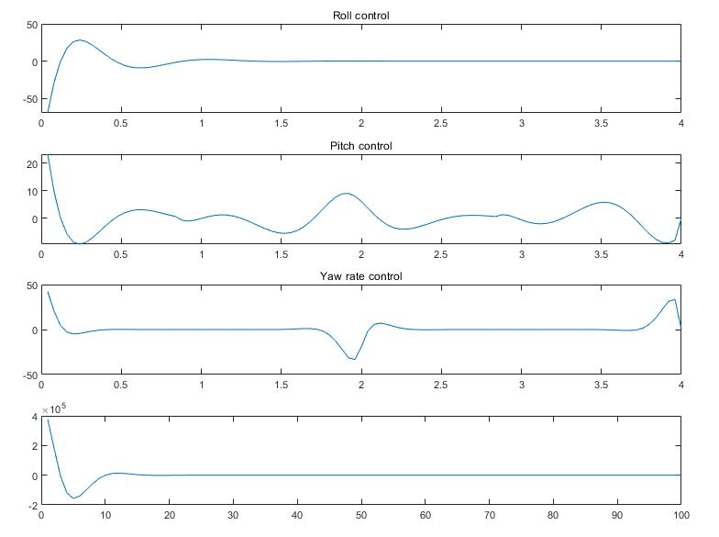
Simulated MPC with no constraints
1. Set up device communications
2. Simulate CrazyFlie control system
3. Design Simulation Controller
4. Implement Controller on CrazyFlie
Simulation time (s)
Simulation time (s)
Notes:
Kevin

Slide 18
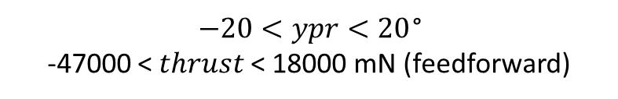
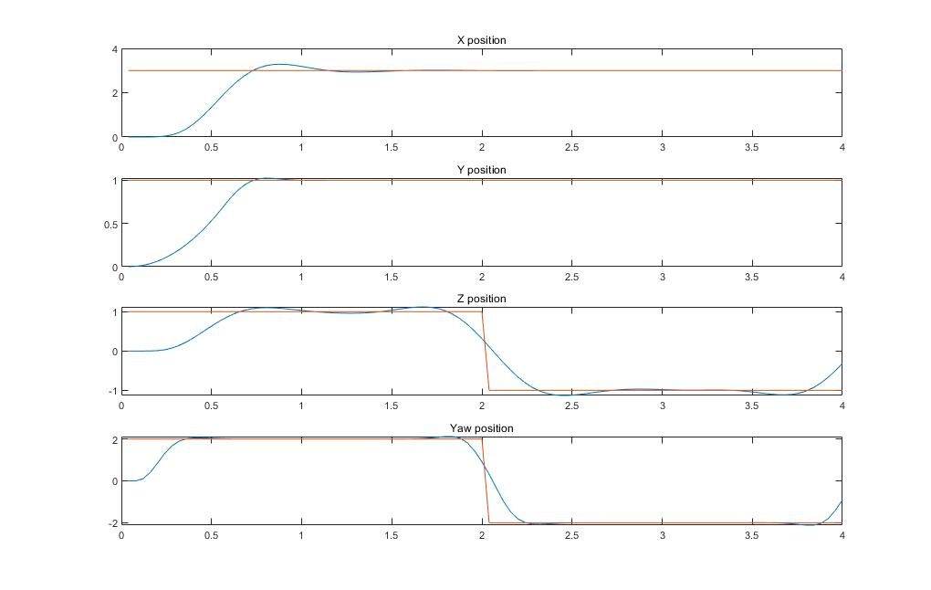
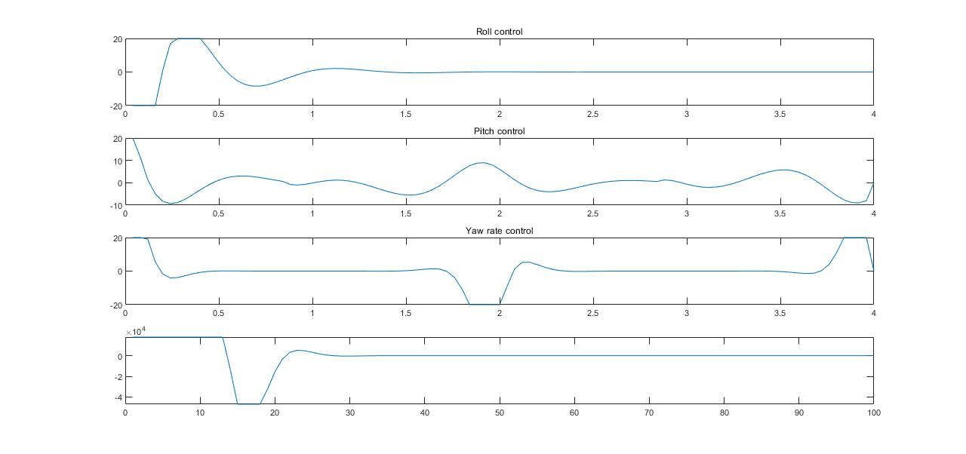
Simulated MPC with input constraints
1. Set up device communications
2. Simulate CrazyFlie control system
3. Design Simulation Controller
4. Implement Controller on CrazyFlie
Simulation time (s)
Simulation time (s)
Notes:
Kevin

Slide 19
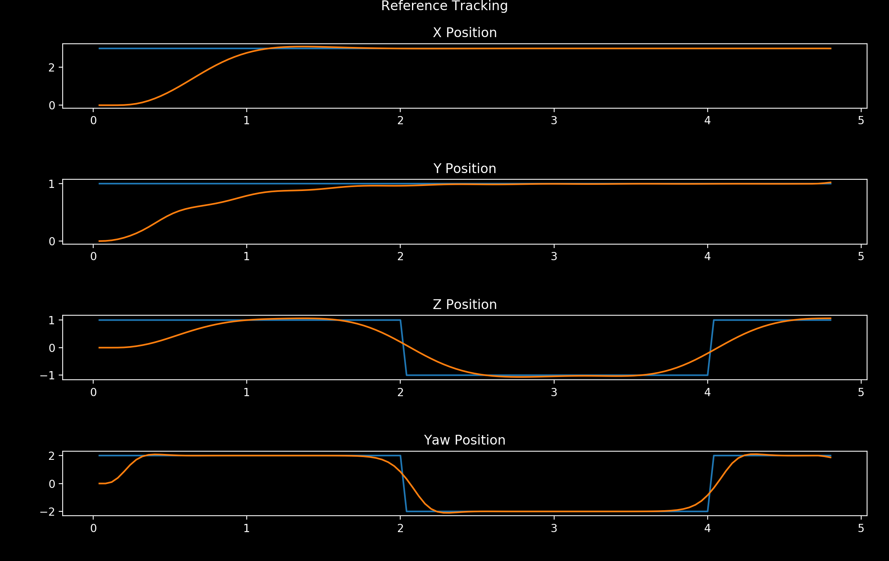
Simulated MPC in Python
1. Set up device communications
2. Simulate CrazyFlie control system
3. Design Simulation Controller
4. Implement Controller on CrazyFlie
Notes:
Rory

Slide 20
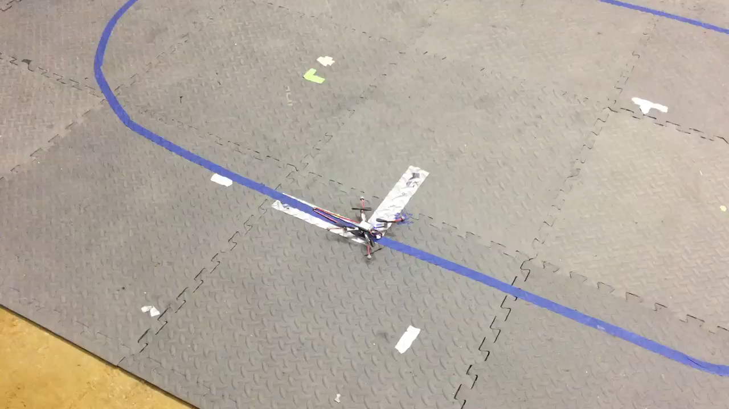
Experimental Results
1. Set up device communications
2. Simulate CrazyFlie control system
3. Design Simulation Controller
4. Implement Controller on CrazyFlie
Notes:
Rory

Slide 21
Discussion
PID performance:
Simple to implement
Reaches set points but not completely following minimum jerk trajectory
MPC performance:
Complex implementation
State estimation issues
Crazyflie limitations
Notes:
Grant

Slide 22
Thank you!

